Slide 1
Epoxy Resins
These polymers are given epoxy name because the monomer & polymer (before cross linking ) contains epoxide groups.
The epoxy polymer is obtained by condensation reaction between an epoxide group & phenolic –OH group
Epoxy resins are prepared by epichlorohydrin & bis phenol A (Di-phenylol propane)
Epichorohydrin is prepared by chlorination of propene
Bisphenol A is prepared by phenol & acetone

Slide 3
Properties
Due to stable ether linkage-high resistance to water
Due to polarity in molecules-Shows excellent adhesive property
Resistant to heat & chemicals
Applications
Used in surface coating material, adhesive materials, in lamination, skid resistant material, Electrical equipments etc.
E.g. Araldite, M-seals, Epikote resins

Slide 4
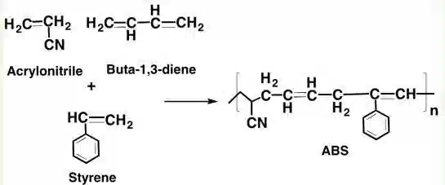
Acrylonitrile Butadiene Styrene ABS
ABS is terpolymer(copolymer consisting of three distinct monomers) made by polymerising styrene & acrylonitrile & butadiene
The nitrile group from neighbouring chains being polar attract each other & binds the chain together, making ABS stronger than pure polystyrene

Slide 5
Properties
ABS are impact resistance & toughness
Resistance can be amplified by increasing the proportion of polybutadiene in relation to styrene & acrylonitrile.
ABS have useful characteristics within a temperature range from 20 ⁰C to 80 ⁰ C
Applications
Home appliances, car interior/Dashboard, TV/Computer cabinets, keyboard, helmet, medical devices etc.

Slide 6
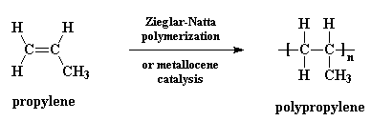
Polypropylene
It is synthesized by the polymerisation of propylene using the famous Ziegler-Natta catalysts.
The monomer is propylene

Slide 7
Properties
Toughness and flexible
Thermal resistant
Resistant to organic solvents
Resistant to oxidizing agents
Soluble in some organic nonpolar solvents like xylene
Applications
It is resistant to chemicals and corrosion
Polypropylene can be employed for the manufacturing of plastic laboratory items and also plastic medical items

Slide 8
SPECIALITY OF POLYMERS
CONDUCTING POLYMERS
Bad conductor of electricity—No free electrons
Intrinsically Conducting Polymers ICP – Conjugated pi-electron system
Electric field Applied-Pi-electrons delocalized, get excited
Electron transported through the resonance
Increase in conjugation – Increases the conductivity in large extent
e.g.Polyacetylene,Polyaniline,Polypyrrole,Polythiophene etc.

Slide 9
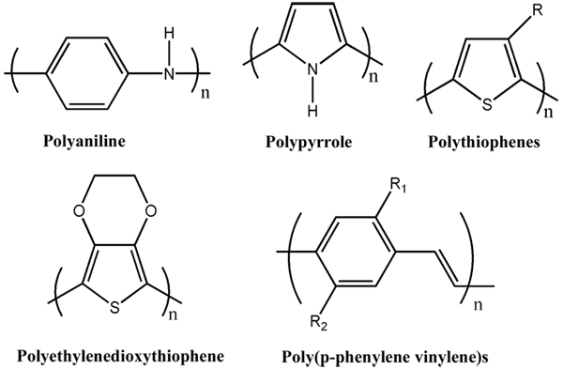
Structural requirements - Conjugation, Hetero atom,Lone pair of electrons,Planarity etc.

Slide 10
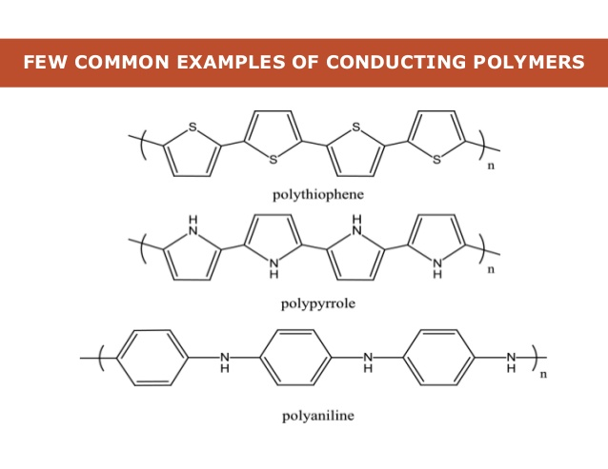

Slide 11
DOPING
Intrinsically Conducting Polymers (ICP)– Low conductivity – Conductivity can be improved by creating positive or negative charge on the polymer chain by oxidation or reduction this technique is called DOPING.
P-Doping:- It includes doping of ICP with a Lewis acid - Electron pair acceptor - (I₂,Br₂,PF₆,FeCl₃)
Oxidation — Removal of electrons —Positive charge will develop.

Slide 12
N-Doping
It includes doping of ICP with a Lewis base – Electron pair donor (Li,Na,Naphthyl amine)
Reduction - Addition of electrons —Negative charge will develop
Application:-
In rechargeable light weight batteries, doped conducting polymers.
In electronic devices such as transistors, photodiodes, LED,sensors etc.

Slide 13
BIODEGRADABLE POLYMERS
Biodegradation of polymers is a process carried out by biological systems (usually bacteria or fungi) wherein a polymer chain is cleaved via enzymatic activity.
Various factors are responsible for biodegradation of polymers like; Microorganisms, environment, nature of polymer.
Stuctural requirement for biodegradable polymers tend to consist of ester, amide, or ether bonds.

Slide 14
Biopol- Poly(hydroxybutyrate,hydroxyvalarate) PHBV
PHBV stands for Poly(3-hydroxybutyrate-co-3-hydroxyvalerate). It is a copolymer.
PHBV undergoes bacterial degradation in the environment.
Polyhydroxybutyrate(PHB)-
PHB is produced by the fermentation of glucose by the bacteria Alcaligens eutrophus.
Polyhydroxyvalarate(PHV)-
PHV can be prepared by A.eutrophus or P.Oleovorans
Applications:
As packaging material, Medical field, Agriculture etc.

Slide 15
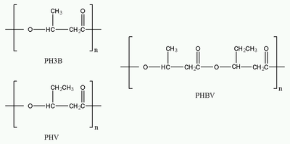
Chemical structures of PHB, PHV and their copolymer PHBV

Slide 16
LIQUID CRYSTAL POLYMERS-LCP
Intermediate stage can be identified called as Liquid Crystal Polymers.
Solid- Mesomorphic or Liquid crystal phase –Liquid.
A polymer that under suitable conditions of temperature, pressure & concentrations, exist as liquid crystals
LCP are of two types;
Thermotropic Liquid Crystals:- Obtained by increase in temperature
Lyotropic Liquid Crystals:- Obtained by addition of Solvents

Slide 17
There are three forms of Liquid Crystals Structures;
i)Smectic State:- Arranged in parallel and lateral order
ii) Nematic State:- Arranged as parallel but not in lateral order.
iii) Cholesteric State:- Oriented parallel to one another but the direction vary from one layer to another layer

Slide 18
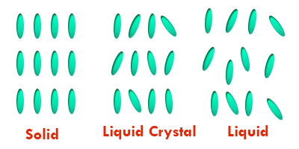
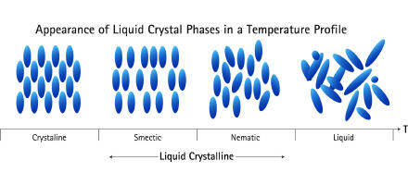

Slide 19
Applications:-
In electronic & electrical equipments like flat panel displays, switches, Computer memory modules, fiber optic cables, In data storage discs etc.

Slide 20
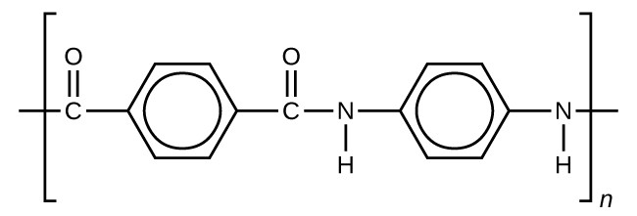
LCP-KEVLAR
Kevlar is an aromatic polyamide (Aramid).The chemical composition of Kevlar is poly-para phenylene terephthalamide.
It is prepared by terephthalic acid dichloride & P- Phenylene di-amine
Properties:- High strength, thermally stable
Applications:-Air craft body, high performance race cars, vehicle tyres etc.

